Slide 1
Artificial Intelligence

Slide 2
Outline
Concept of rationality
Rational Agent
Agent and environment
Structure of Intelligent Agents
Types of Agents
Problems in AI

Slide 3
Concept of Rationality

Slide 4
Rational
based on or in accordance with reason or logic.
Rational meaning: logical / reasoned / reasonable / coherent.

Slide 5
Rational Person
A rational person is someone sensible and able to make decisions based on intelligent thinking rather than on emotion. (Def from dictionary)

Slide 6
Rationality
The ability to make decisions based on logical reasoning and optimized behavior to achieve some goals,
considering the perception (observation/awareness) of environment.

Slide 7
Rationality
the quality of being guided by reasons or being reasonable.
For example, a person who acts rationally has good reasons for what they do.
This usually implies that they reflected on the possible consequences of their action and the goal supposed to achieve.

Slide 8
Rationality
Its nothing but status of being reasonable, sensible, and having good sense of judgment.
is concerned with expected actions and results depending upon what the agent has perceived.
Performing actions with the aim of obtaining useful information is an important part of rationality.

Slide 9
Rational Agents

Slide 10
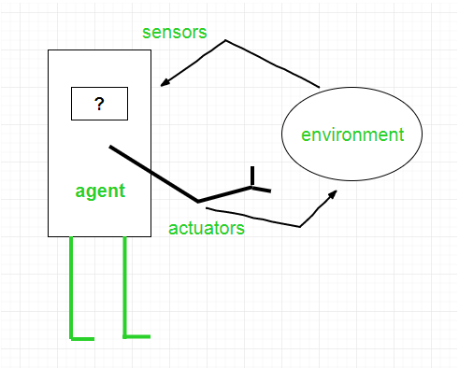
Agent
An agent is anything that can perceive (observe / notice) its environment through sensors and acts upon (or respond to) that environment through actuators(effectors).
An AI system is composed of an agent and its environment.

Slide 11
Agent
An agent can be anything that makes decisions, as a person, firm, machine, or software.
A human agent has sensory organs such as eyes, ears, nose, tongue and skin parallel to the sensors, and other organs such as hands, legs, mouth, for effectors.

Slide 12
Agent
A robotic agent replaces cameras and infrared range finders for the sensors, and various motors and actuators for effectors.
A software agent has encoded bit strings as its programs and actions.

Slide 13
Some Applications of intelligent agents
Medical diagnosis
Vacuum cleaning
Autonomous driving
Information search, retrieval, and navigation
Repetitive office activities and so on…
Notes:
Applications of intelligent agents
Intelligent agents in artificial intelligence have been applied in many real-life situations.
Information search, retrieval, and navigation
Intelligent agents enhance the access and navigation of information. This is achieved through the search of information using search engines. The internet consists of many data objects that may take users a lot of time to search for a specific data object. Intelligent agents perform this task on behalf of users within a short time.
Repetitive office activities
Some companies have automated certain administrative tasks to reduce operating costs. Some of the functional areas that have been automated include customer support and sales. Intelligent agents have also been used to enhance office productivity.
Medical diagnosis
Intelligent agents have also been applied in healthcare services to improve the health of patients. In this case, the patient is considered as the environment. The computer keyboard is used as the sensor that receives data on the symptoms of the patient. The intelligent agent uses this information to decide the best course of action. Medical care is given through actuators such as tests and treatments.
Vacuum cleaning
AI agents are also used to enhance efficiency and cleanness in vacuum cleaning. In this case, the environment can be a room, table, or carpet. Some of the sensors employed in vacuum cleaning include cameras, bump sensors, and dirt detection sensors. Action is initiated by actuators such as brushes, wheels, and vacuum extractors.
Autonomous driving
Intelligent agents enhance the operation of self-driving cars. In autonomous driving, various sensors are employed to collect information from the environment. These include cameras, GPS, and radar. In this application, the environment can be pedestrians, other vehicles, roads, or road signs. Various actuators are used to initiate actions. For example, brakes are used to bring the car to a stop.
https://www.section.io/engineering-education/intelligent-agents-in-ai/

Slide 14
Agent Terminologies
Performance Measure of Agent − It is the criteria, which determines how successful an agent is.
Percept − It is agent’s perceptual inputs at a given instance.
Percept Sequence − It is the history of all that an agent has perceived till date.

Slide 15
Agent Terminologies
Agent Function − It is a map from the precept sequence to an action.
Agent program − It is the implementation or execution of the agent function
action that agent performs after any given sequence of percepts.

Slide 16
Rational Agent
is a computer program that uses logical reasoning and the ability to make decisions to determine its following action.

Slide 17
Rational Agent
An excellent example of a rational agent is a chess player.
A chess player can analyze the board and determine which moves will result in the most advantageous outcome for itself.

Slide 18
Rational Agent
It can move one piece over another, move its king out of danger, or attack an opponent's piece.

Slide 19
Rational Agent
An ideal rational agent is the one, which performs expected actions to maximize its performance measure.
A rational agent always performs right actions, that causes the agent to be most successful in the given percept sequence.
The problem that agent solves is characterized by Performance Measure, Environment, Actuators, and Sensors (PEAS).

Slide 20
Rational Agent
A rational agent has four primary characteristics:
Perception: The ability to perceive the current state of the environment and gather relevant information.
Actuators: The ability to take actions within the environment to achieve its goals.

Slide 21
Rational Agent
A rational agent has four primary characteristics:
Performance measure: A way to evaluate the success or failure of the agent's actions.
Rationality: The ability to make decisions based on logical reasoning and optimize behavior to achieve its goals, considering its perception of the environment and the performance measure.

Slide 22
Example1: Taxi driver example
Performance measure
safe, fast, legal, comfortable trip, maximize profits
Environment
roads, other traffic, pedestrians, customers
Actuators
steering, accelerator, brake, signal, horn, display
Sensors
camera, speedometer, GPS, engine sensors,
Notes:
DARPA urban challenge 07:
http://www.youtube.com/watch?v=SQFEmR50HAk

Slide 23
Example 2: Medical Diagnosis System
Performance measure
healthy patient, minimize costs, lawsuits
Environment
patient, hospital, staff
Actuators
display questions, tests, diagnosis, treatments,
Sensors
keyboard entry of symptoms, findings, patient’s answers.

Slide 24
Why Rational Agents?
Rational agents are essential for several reasons:
Real-world applications: Rational agents can be used to control autonomous systems such as self-driving cars, robots, or drones, to make financial decisions, or to plan logistics.
Optimization: Rational agents can optimize their behavior to achieve a specific goal, considering the current state of the environment, the available resources, and the constraints.

Slide 25
Why Rational Agents?
3. Decision-making: Rational agents can make decisions based on logical reasoning and optimize their behavior to achieve their goals,
considering their perception of the environment and the performance measure;
this allows for better decision-making.
4. Adaptability: Rational agents can learn from their environment and adapt their behavior.
This allows them to improve their performance over time.

Slide 26
Why Rational Agents?
5. Autonomy: Rational agents can operate independently of human intervention.
This can lead to increased efficiency and reduced human error.

Slide 27
Agent and Environment

Slide 28
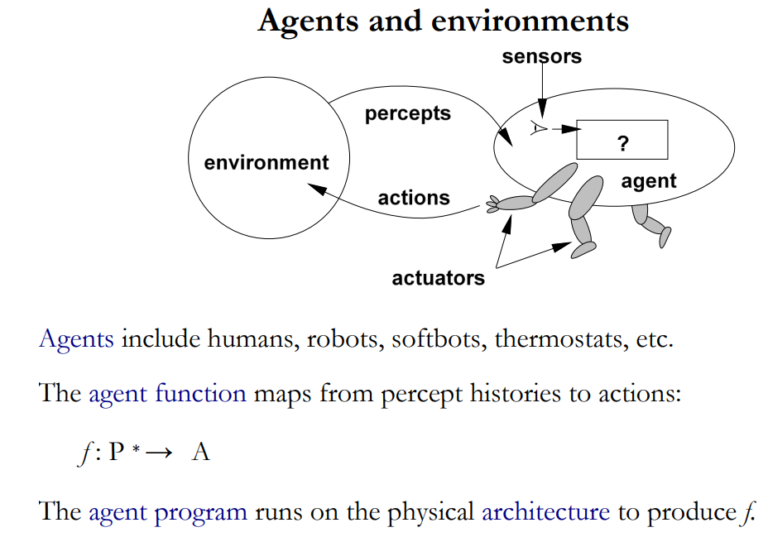
Agent and Environment

Slide 29
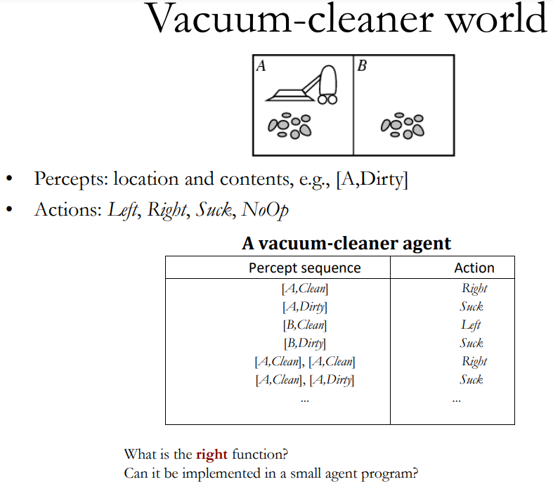
Agent and Environment

Slide 30
Properties of Task Environment
Discrete (vs. continuous)
If a limited number of distinct, clearly defined, states of the environment, the environment is discrete (For example, chess); otherwise it is continuous (For example, driving).
Fully Observable (vs. partially observable)
If it is possible to determine the complete state of the environment at each time point, it is observable e.g. Image Recognition; otherwise it is only partially observable e.g. Self-Driving.
Single agent (vs. multiagent)
An agent operating by itself in an environment

Slide 31
Contd..
Static (vs. dynamic)
If the environment does not change while an agent is acting, then it is static; otherwise it is dynamic.
Accessible (vs. Inaccessible)
Whether the complete state of the environment is accessible by agent’s sensory apparatus
Deterministic (vs. stochastic)
Whether the next state of the environment is exactly determined by the current state and the actions of the agent

Slide 32
Example 1: Taxi Driver
Discrete or continuous
Continuous
Fully Observable or partially observable
partially
Single agent or multi-agent
Multi-agent
Static or dynamic
dynamic
Accessible or Inaccessible
Inaccessible
Deterministic or stochastic
Stochastic

Slide 33
Example 2: Chess with a clock
Discrete or continuous
Discrete
Fully Observable or partially observable
Fully
Single agent or multi-agent
Multi-agent
Static or dynamic
Semi-dynamic
Accessible or Inaccessible
Accessible
Deterministic or stochastic
Deterministic (strategic)

Slide 34
Structure of Intelligent Agents
The IA structure consists of three main parts:
Architecture: The machinery that an agent executes on. It is a device with sensors and actuators, for example, a robotic car, a camera, a PC
Agent function: a function in which actions are mapped from a certain percept sequence
Agent Program: an implementation or execution of an agent function.
Normally, Agent’s structure can be viewed as:
Agent = Architecture + Agent Program

Slide 35
Types of Agents

Slide 36
Types of Agents
Agents can be grouped into five classes based on their degree of perceived intelligence and capability:
Simple Reflex Agents
Model-Based Reflex Agents
Goal-Based Agents
Utility-Based Agents
Learning Agent

Slide 37
Simple Reflex (reaction/response) Agents
Most basic of the intelligent agents
perform actions based on a current situation (percept)
They are rational only if a correct decision is made based on current precept.
Their environment is completely observable.
They are built on the Condition-Action Rule
Perform action if a specific condition is fulfilled
Examples:
home thermostat, chess etc.

Slide 38
Contd..
Problems with Simple reflex agents are :
Very limited intelligence.
No knowledge of non-perceptual parts of the state.
If there occurs any change in the environment, then the collection of rules need to be updated.

Slide 39
Model-based reflex agents
These agents use an internal model that determines the percept history and effect of actions
Can work well in a partially observable environment
They maintain an internal state.
a representation of unobserved aspects of current state depending on percept history.
Updating the state requires the information about:
how the world evolves independently from the agent
how the agent’s actions affect the world.
Example: self driving car slows down when sees red lights of the front car. Or car changing its line

Slide 40
Goal Based Agents
They choose their actions to achieve goals
More flexible and adaptive than reflex agents as goal information is also included
Can change goal without need to “reprogram” rules, for example a new destination for the taxi-driving agent
Example: driverless cars can also be example when they are programmed with an end destination, or goal, in mind.
The car will then ''think'' and make the right decisions to deliver the passenger where they intended to go.

Slide 41
Utility Based Agents
Like goal-based agents but chooses the action that maximizes the outcome
They choose actions based on a preference (utility/usefulness) for each state
Utility describes how “happy” the agent is
Achieving the desired goal is not enough instead look for a quicker, safer, cheaper trip to reach a destination
Example:
Price comparison shopping
Bidding on items in an auction (sale)
Evaluating bids in an auction (sale)

Slide 42
Learning Agent
These agents have the capability to learn from their previous experiences
It starts to act with basic knowledge, analyze performance, and look for new ways to improve on those tasks, automatically.
Example: self-driving car stuck on the road, will change path next time

Slide 43
Which type of shopping agent will be best?
When Navigating: Move around store; avoid obstacles
Reflex agent
Gathering: Find and put into cart groceries it wants, need to induce objects from percepts
Reflex agent: walk and grab items that look good.
Goal-based agent: shopping list.
Menu-planning: Generate shopping list, modify list if store is out of some item
Goal-based agent: required; what happens when a needed item is not there? Achieve the goal some other way. e.g., no milk cartons: get canned milk or powdered milk.
Choosing among alternative brands
Utility-based agent: trade off quality for price

